Slide 1
Rotary District 7020 Hurricane Recovery APP
Notes:
Good morning everyone, I hope everyone can see the screen…OK?
We want to share some information on the District 7020 Hurricane Recovery APPs, of the background to how it evolved, how the APP is used by Rotarians and partners, and a little of the behind the scenes technical implementation as we discuss how it can be easily used and shared by other Rotary districts.

Slide 2
Notes:
I am Michael Terrelonge of the RC of Spanish Town and proud member of Rotary District 7020

Slide 3
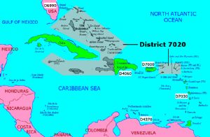
Notes:
Our district comprises … 84 Rotary clubs in 10 different countries or territories in two geographical areas in the Northern and Eastern Caribbean, separated by Dominican Republic (District 4060) and Puerto-Rico (District 7000). With District 7030 to the south,
You need a better resolution pic

Slide 4
Background
Hurricane IRMA & MARIA struck the Eastern Caribbean in Sept 2017
Rotary and District 7020 was quick to respond
District Governor Robert Ledger immediately convened a “District Hurricane Recovery Committee”
The HRC needed a system to manage information about recovery activities
A set of APPs were created to help Rotarians & Partners coordinate the recovery process
Notes:
In Sept 2017, back to back Category 5 hurricanes ravaged 6 of our 10 islands and Rotary was quick to respond, DG of 7020 Robert Ledger immediately convened a committee to respond, and this committee quickly recognized the need to manage the numerous pieces of information related to the recovery effort. A set of APPs were created to help Rotarians and partners coordinate the disaster recovery process.

Slide 5
The App helps to manage:
Contacts
with external individuals seeking to help recovery efforts
Offers
of assistance (in-person, materials, TRF global grants and other non-financial)
Financial Contributions
…. managed separately outside the APP
Projects
Status
Coordinators
Hurricane Recovery Projects
updates on each island (Rotary District 7020 spans 10 islands!)
for each Island and Club Project
Notes:
the APP helps Rotarians in managing important items of information critical to the disaster recovery process.
Such as -
– Contacts – details of individuals and organizations related to the recovery efforts
- Projects – ‘ the many projects being planned and executed by local Rotarians on the ground in the affected communities
Status - of islands,
Rotary coordinators on the ground in each island and
Offers – Offers of assistance from Rotarians and partners the world over.

Slide 6
Rotary D7020 Disaster Recovery Project Lifecycle
Rotary Club
Community Needs Identified & Assessed
District HRC Review
Project Review
Implementation
Project Implementation
Close Out
Goals
Club decides to seek district support
Funding request submitted into APP
Committee Review & Approval
Project Funding provided
Stewardship Reporting
Project Close Out
Post-Project Evaluation
Meets Community Needs
Sustainable
On-Time
Within Budget
District Project Monitoring & Coordination (ongoing)
Notes:
Rotary Clubs.... on the ground assess their community needs and formulate projects that may need district assistance.....These clubs submit their project funding application requests to the district via the APP,
.... Which is forwarded to the district hRC,
... The HRC reviews the project and appropriate projects are approved and funded.
... Projects are implemented by the local Rotary clubs
.... There are preliminary, in process and final stewardship reports that are mandated and tracked.
..... Finally projects are completed and close-out and post-evaluation done.
..... This enables us to achieve our goals of satisfying local community needs with good and sustainable projects.
..... The Hurricane disaster recovery committee monitors and coordinates the overall process for all projects

Slide 7
Roles
Rotary Clubs
Submit requests District funding assistance
Interact with District concerning needs, partners, Offers etc.
Rotary Island Coordinators/Assistant Governors
Submit routine status updates on their island
Assist Clubs in submitting projects, reporting etc to District
Review opportunities for partnership available from OFFERS
District Hurricane Recovery Committee (HRC)
Manage recovery projects through lifecycle to achieve goals
Manage & follow-up on Contacts, Offers, etc.
Administer the APP system (users, APP features, training etc)
Partners & Public
View details of activities in real time
Train users (who should we involve?)
Committee
Country Coordinators
Project Managers
Other Key persons
Identify who will update/add specific info
Individuals will then add/update their respective entries, others will observe
Monitor and support deployment, assist users
Other considerations?
Notes:
These are the ROLES Rotarians play in the recovery process and the APP contains facilities designed to satisfy the needs of various users and ROLES in the recovery process
- Rotary Clubs need to submit projects requesting district funding, and assistance with satisfying their project needs and gaining partners, learning of offers of asasistance etc.
- Rotarians on the ground acting as coordinators can submit their location status and assist clubs throughout the project lifecycle as well as reciew OFFERS
- The HRC manages the overall recovery process and needs all members to be able to see the same up to date information
- Partners and the Public can view certain selected items of information in real time.

Slide 8
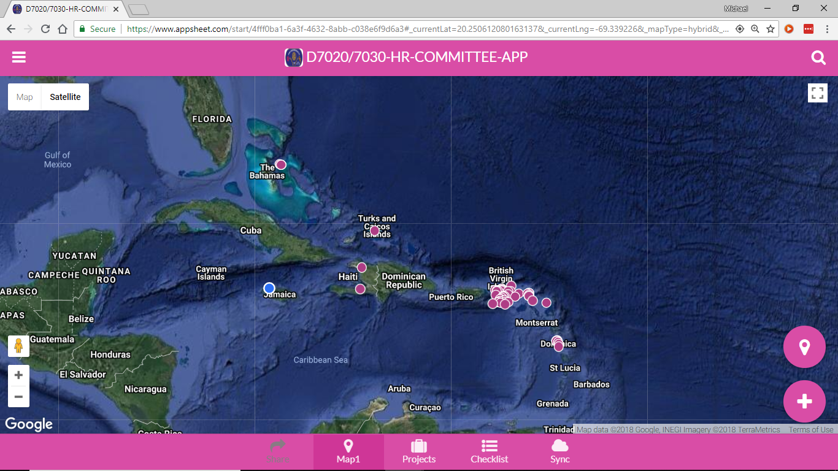
Map of Projects
Notes:
Facilities exist for using exact gps location for each project, which allows for maps to be produced of projects with full Google Maps functionality

Slide 9
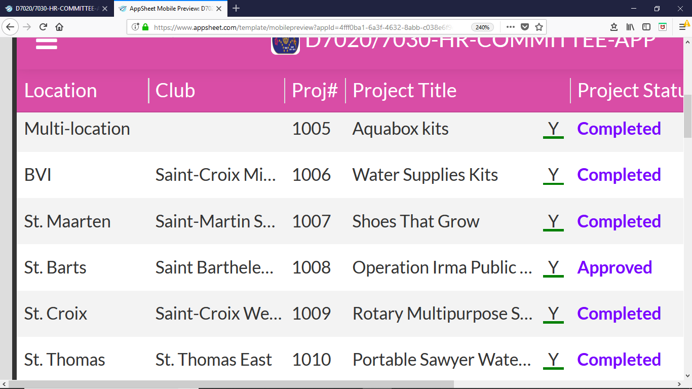
D7020 Hurricane Recovery APP ‘Projects’ screen
Notes:
Here is the projects screen and the drill down to each individual project details
Clubs enter their project details, attach pictures, gps locations and other documents

Slide 10
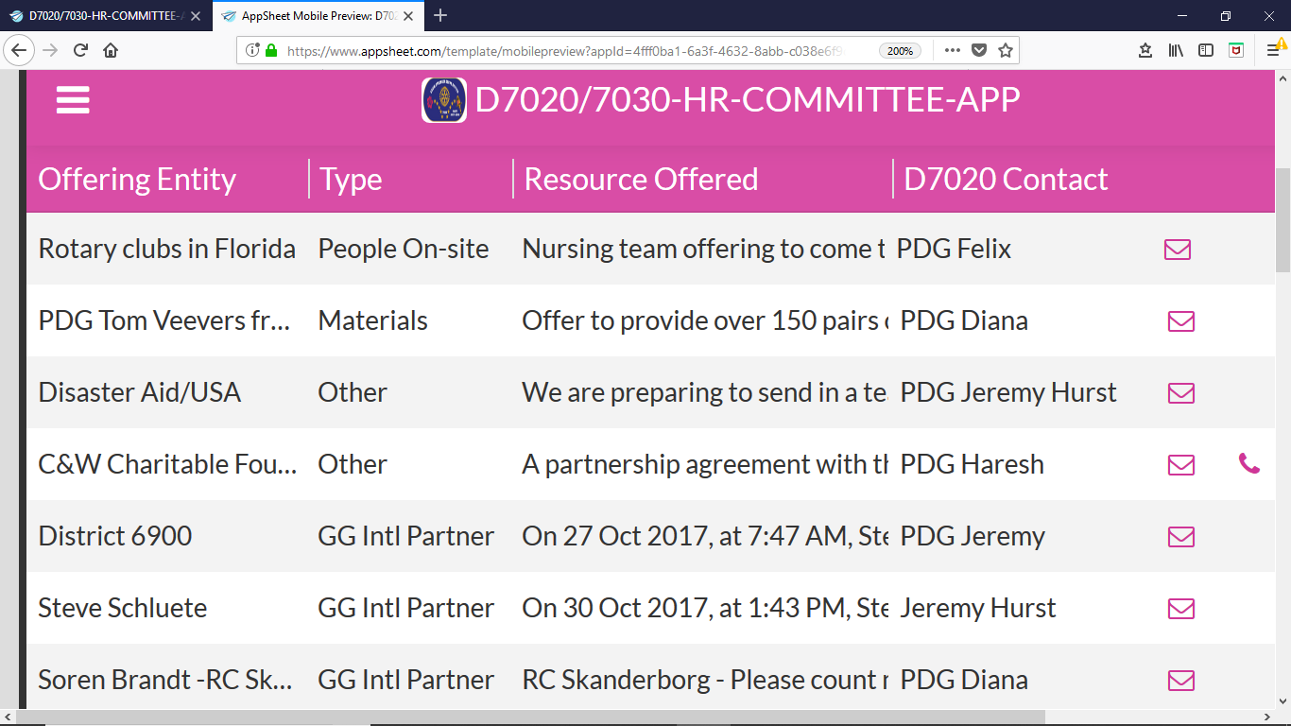
D7020 Hurricane Recovery APP ‘Offers’ screen
Notes:
This is how the kind OFFERS of assistance from Rotarians and partners the world over are managed. This enables us to manage the relationships extended and coordinate assistance to clubs

Slide 11
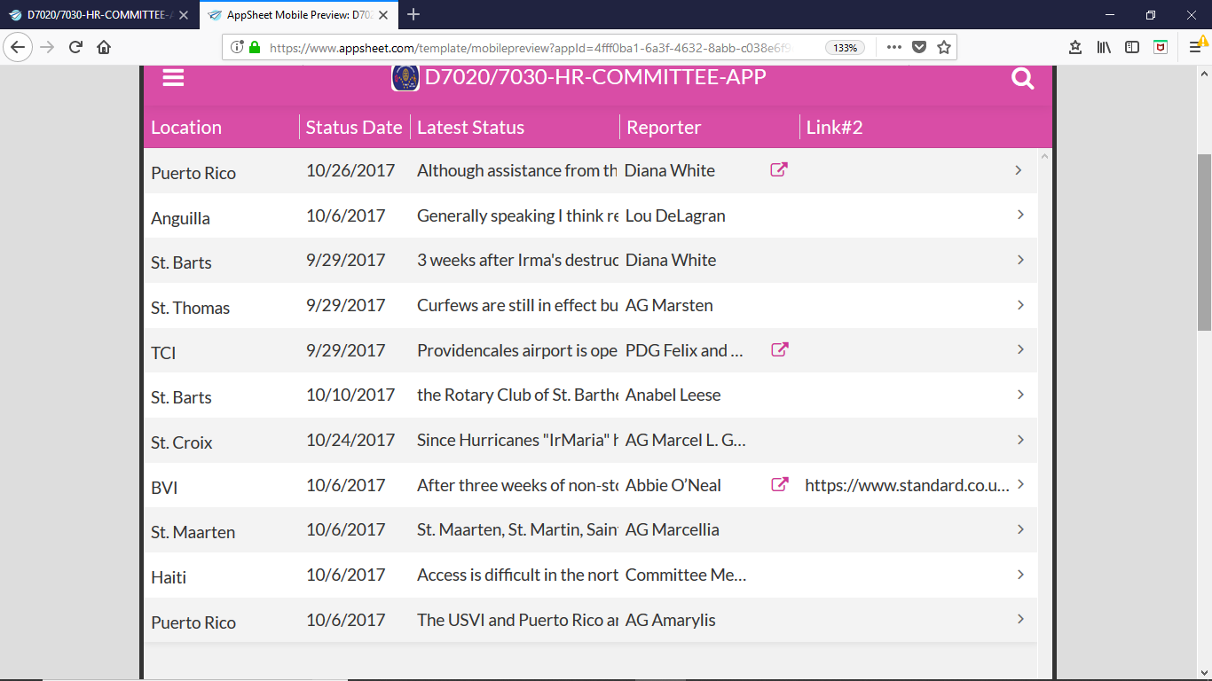
D7020 Hurricane Recovery APP ‘Island Status’ screen
Notes:
This how we keep the latest updates on each island location in the APP.

Slide 12
D7020 Hurricane Recovery APP ‘Contacts’ screen
Notes:
We establish many contacts from Rotarians and partners and to effectively manage relationship a common listing of these contacts comes in very helpful to the committee.

Slide 13
D7020 Hurricane Recovery APP ‘Country Coordinators’ screen
Notes:
Keeping in touch with Coordinators in each island location is critical and this is how we keep track of them.

Slide 14
D7020 Hurricane Recovery APP Additional features - ‘Menu views’
Menu views
Notes:
The APP contains an additional MENU button at the Top Left which shows many other options available to users

Slide 15
Benefits of the APP
An organized process for responding to disasters.
Effective, widely deployable & transparent
Resilient to disasters – Robust, secure cloud based solution
Potentially a common platform for Rotary clubs and districts to coordinate response.
Notes:
Overall, the APP provides a number of benefits to Rotary District 7020.
It allows an well coordinated and organized process for managing recovery efforts
It enables the HRC to be effective , promotes transparency and is easily deployable to Rotarians widely dispersed in various locations
- The APP is resilient to disasters so that a disaster in one, or even multiple locations will not affect its functioning
- With the active encouragement and support of DNA-RAG the APP was built with the capability to be shared with other Rotary clubs and districts.

Slide 16
Behind the Scenes
How the APP is implemented

Slide 17
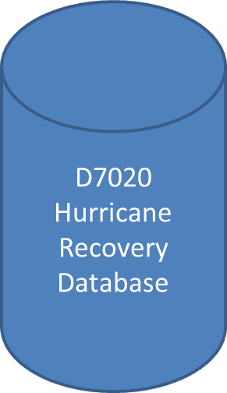
The central database
A shared database (Google Sheet)
Island Status
Contacts
Offers
Projects
Island Coordinators
Central repository details of ALL information (“common song sheet”)
Data available and updated by all users, conveniently in real time, online and/or offline
Notes:
The central database is the common ‘song book’ that enables Rotarians to all to act in unision.
This is be cloud based Google spreadsheet containing all information.
This enables information to be easily shared by ALL

Slide 18
Disaster Recovery Info Must Be Resilient!
All components stored in the cloud
Backed up in multiple places in real-time
Independent of any one location
Can be used and administered from anywhere
Notes:
The disaster information system must itself survive a disaster and be survival despite demise of a particular location and/or administrator.

Slide 19
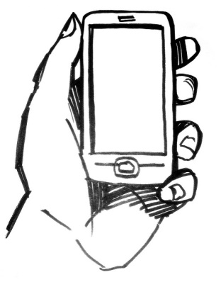
Hurricane Recovery APP User Interfaces
D7020 Hurricane Recovery Database
Web/browser App
Phone/Tablet App (Android/IOS)
Shared Google sheets
Notes:
The overall solution entails a central database and separate end-user tools for working with that information
1.Their is a web app that provides access from a browser, chrome, Edge/IE, Safari, Firefox and the like
2.There is a phone/tablet APP that works on Android and Apple/IOS devices
3.We have been very fortunate to have APPSHEET.com be a technology partner in our efforts, there assistance to us was immediate and tremendously helpful.
4.We are grateful to Appsheet.com, a commercial web services platform company for immediately responding to our request and donating their corporate services for free for this effort. They have a tremendous product and their kind partnership saves us significant expenditures every month

Slide 20
Interacting with Disaster Recovery Info Web & Phone APPS
Easy front end for individual users
Phone/table app ideal for mobile/remote users
Web/browser & phone App have same look & feel
Data can be updated by either
Data stored securely in central database
Notes:
The APP provided thus provides multiple ways for Rotarians to interact with the data, via any web browser of table/phone app.
Both have the same look and feel which enables users to easily use these different ways seamlessly.

Slide 21
Hurricane Recovery APP Phone/Tablet APP
Installs on mobile phone or tablet
(Android and Apple/IOS)
“… is explicitly designed for environments with bad or intermittent connectivity, and the data synchronization technology handles various kinds of failures seamlessly without data loss.” (Appsheet.com)
Same look & feel as browser APP
Notes:
The Phone/Table version of the APP is especially good for persons working offline in the field without intermittent connectivity, data is kept securely on phone and can be periodically synced.
Note buttons at bottom for key features, while the menu button at top left allows access to other options

Slide 22
Next Steps
Continue to use APP to coordinate IRMA/MARIA disaster recovery efforts
Going forward, proactively train Clubs in the ‘recovery process & APP use’
Coordinate with other Districts and partners facilitated by DNA-RAG
Notes:
We will continue to use the APP to coordinate disaster projects, to ensure well delivered projects as we work with partners
Going forward for the upcoming Rotary year, we plan to more proactively train clubs in managing the eventuality of recovery projects and to be able to use the APP.
We plan to improve our capability to coordinate with other districts and partners and to make the APP open for all to use and improve.

Slide 23
Thank you ! Questions & Feedback?
++
District 7020 Hurricane Recovery Committee
Notes:
Thank you for sharing this information on the Rotary District 7020 Hurricane Recovery APPs, background to how it evolved and is used by Rotarians and partners, and a little bit of behind the scenes technical implementation as we discuss how it can be easily used and shared and extended by other Rotary districts..
District 7020 wishes to thank the advice, input and encouragement of DNA-RAG and partners in getting to this stage.
QWERTFGP +] ==-[;/.LJHGFAas

